Slide 1
Transaction merge files
TEAM MEMBERS
A KARTHIKEYA(2010030442)
M GANESH(2010030420)
K MADHU SAI(2010030090)
JASWANTH REDDY(2010039002)
GUIDE
DEEPTHI KALAVALA MAM

Slide 2
Abstract
Our purpose is to study the optimal way to merge n initially sorted runs, stored on a disk like device, into a unique sorted file. This problem is equivalent to finding a tree with n leaves which minimizes a certain cost function .
We shall study some properties of those optimal trees, in the hope of finding efficient ways for constructing them.
In particular, if all the initial runs have the same length, an algorithm for constructing the best merge pattern is described ; its running time is proportional to n 2 and it requires space proportional to n.
A special case is also analyzed in which the problem is solved in time and space proportional to n, and which provides some insight into the asymptotic behaviour of optimal merge trees.

Slide 3
PROBLEM STATEMENT
We will take transactions of day-to-day life in a sorted files
from different branches of bank, and merge them into a single
sorted merge file.
Optimal merge pattern is a set of sorted files of different length combining into a single sorted file. We need to find an optimal solution, where the resultant file will be generated in minimum time.
If the number of sorted files are given, there are many ways to merge them into a single sorted file. This merge can be performed pair wise. Hence, this type of merging is called as 2-way merge patterns.

Slide 4
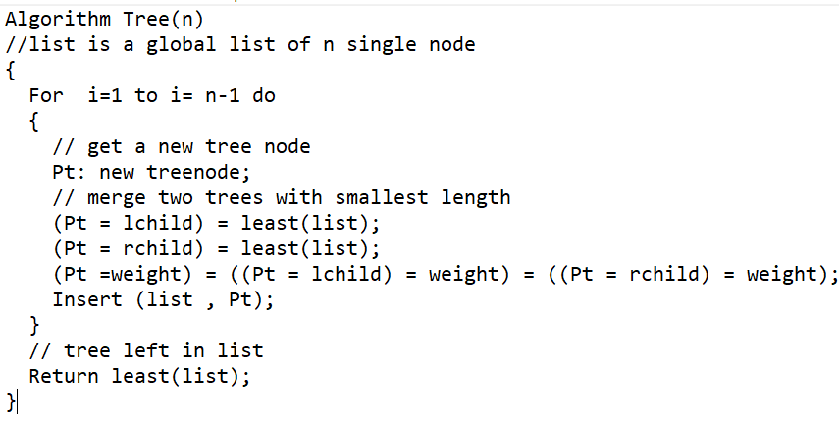
Solution strategy- Algorithm used
Given n number of sorted files, the task is to find the minimum computations done to reach the Optimal Merge Pattern. When two or more sorted files are to be merged altogether to form a single file, the minimum computations are done to reach this file are known as Optimal Merge Pattern.
The function tree algorithm uses the greedy rule to get a two- way merge tree for n files. The algorithm contains an input list of n trees. There are three field child, rchild, and weight in each node of the tree. Initially, each tree in a list contains just one node
If more than 2 files need to be merged then it can be done in pairs. For example, if need to merge 4 files A, B, C, D. First Merge A with B to get X1, merge X1 with C to get X2, merge X2 with D to get X3 as the output file.
If we have two files of sizes m and n, the total computation time will be m+n.

Slide 5
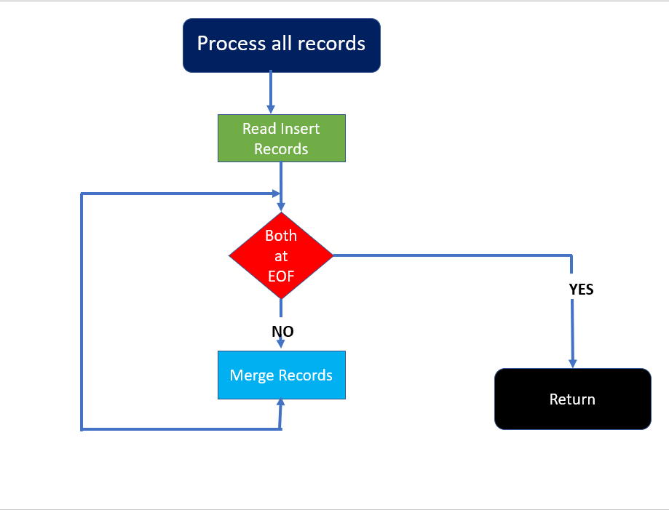
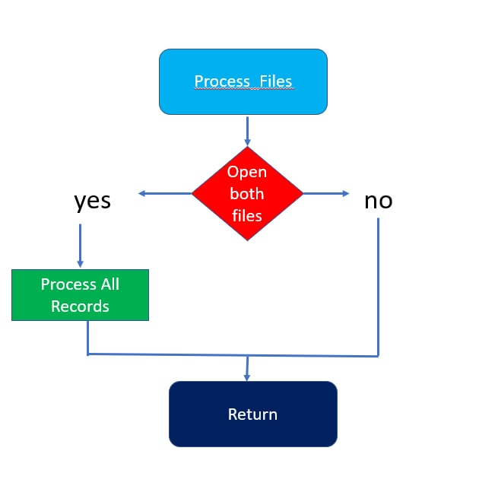
FLOWCHART

Slide 6
Hardware and Software
SOFTWARE REQUIREMENTS
1.PYTHON
2.PYCHARM
3.JUPITER
HARDWARE REQUIREMENTS
1. Processor of i5 Gen.
2. HDD Storage capacity of 1TB
3. RAM OF 8GB

Slide 7
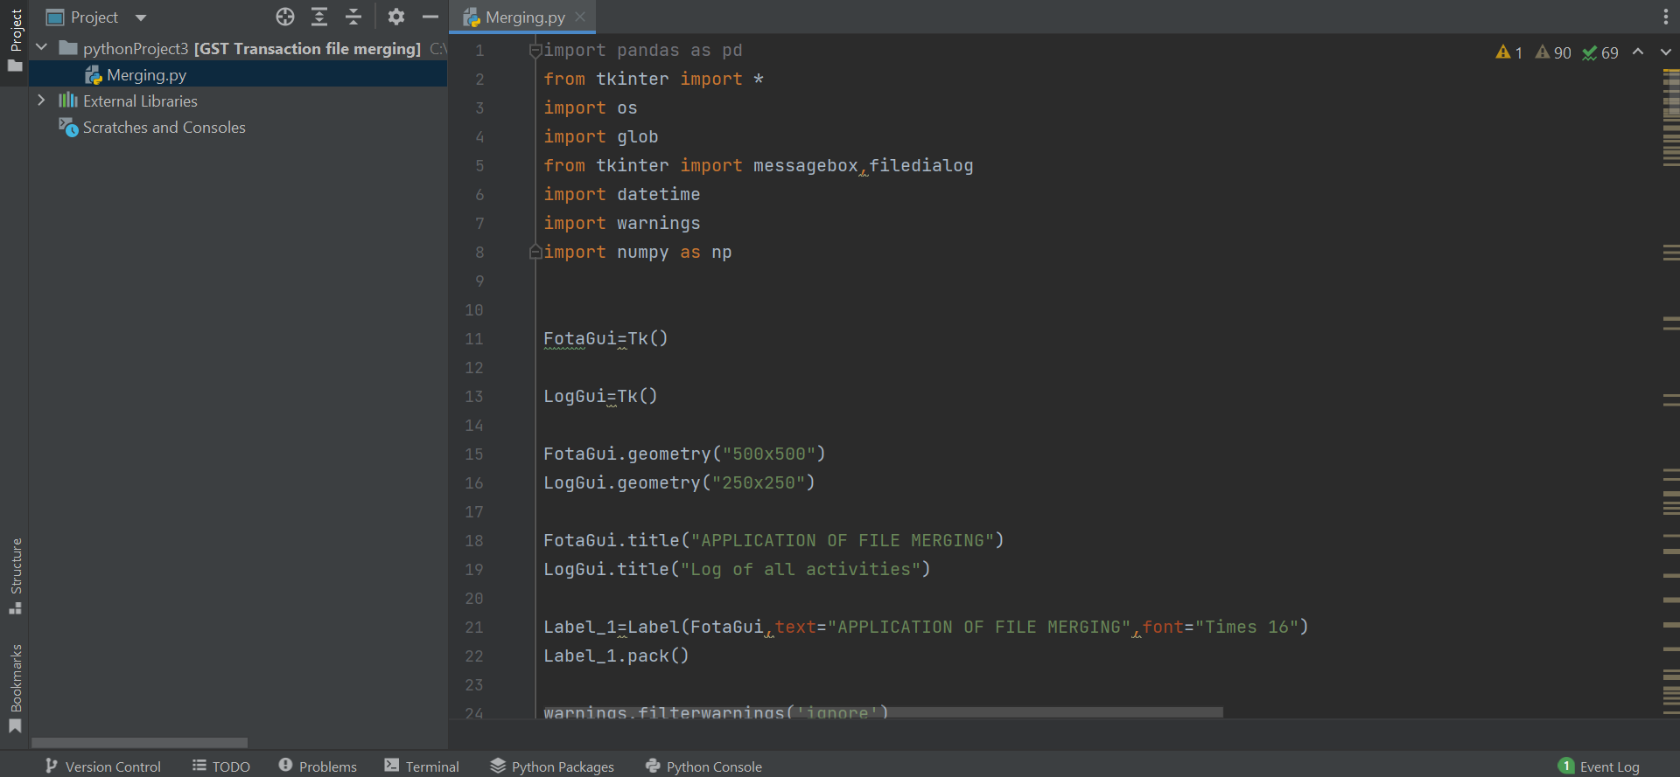
IMPLEMENTATION

Slide 8
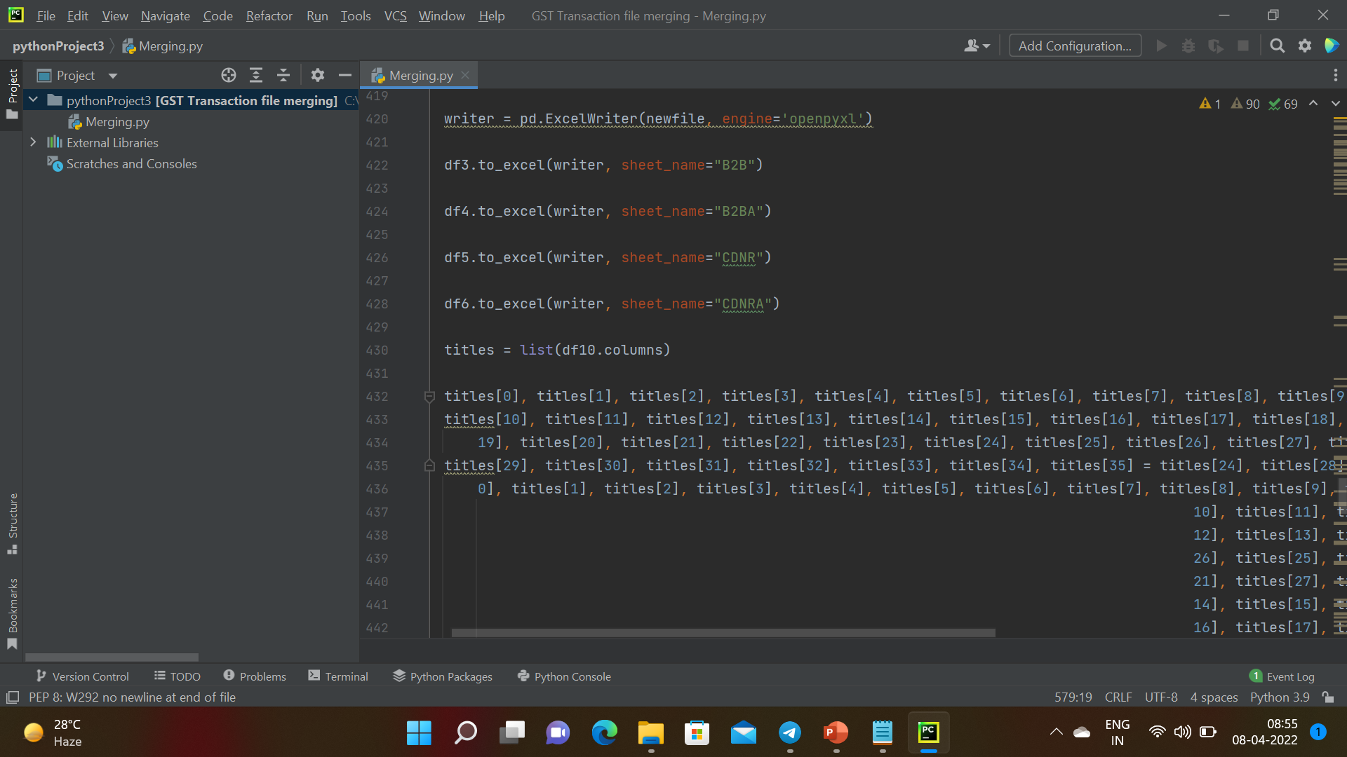

Slide 9
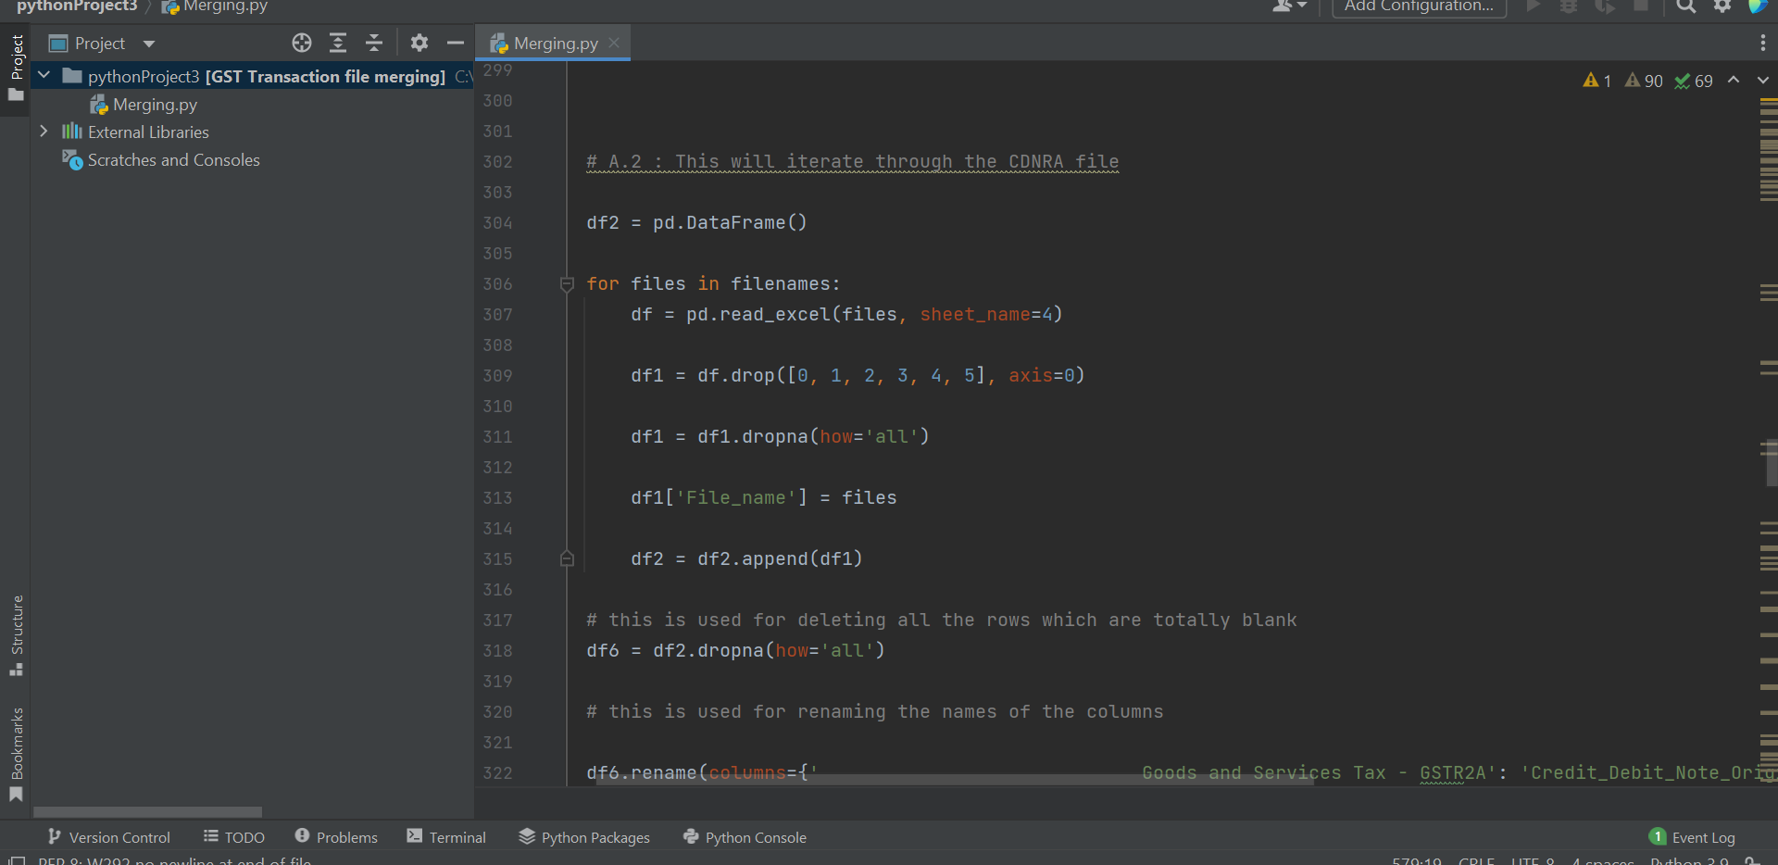

Slide 10
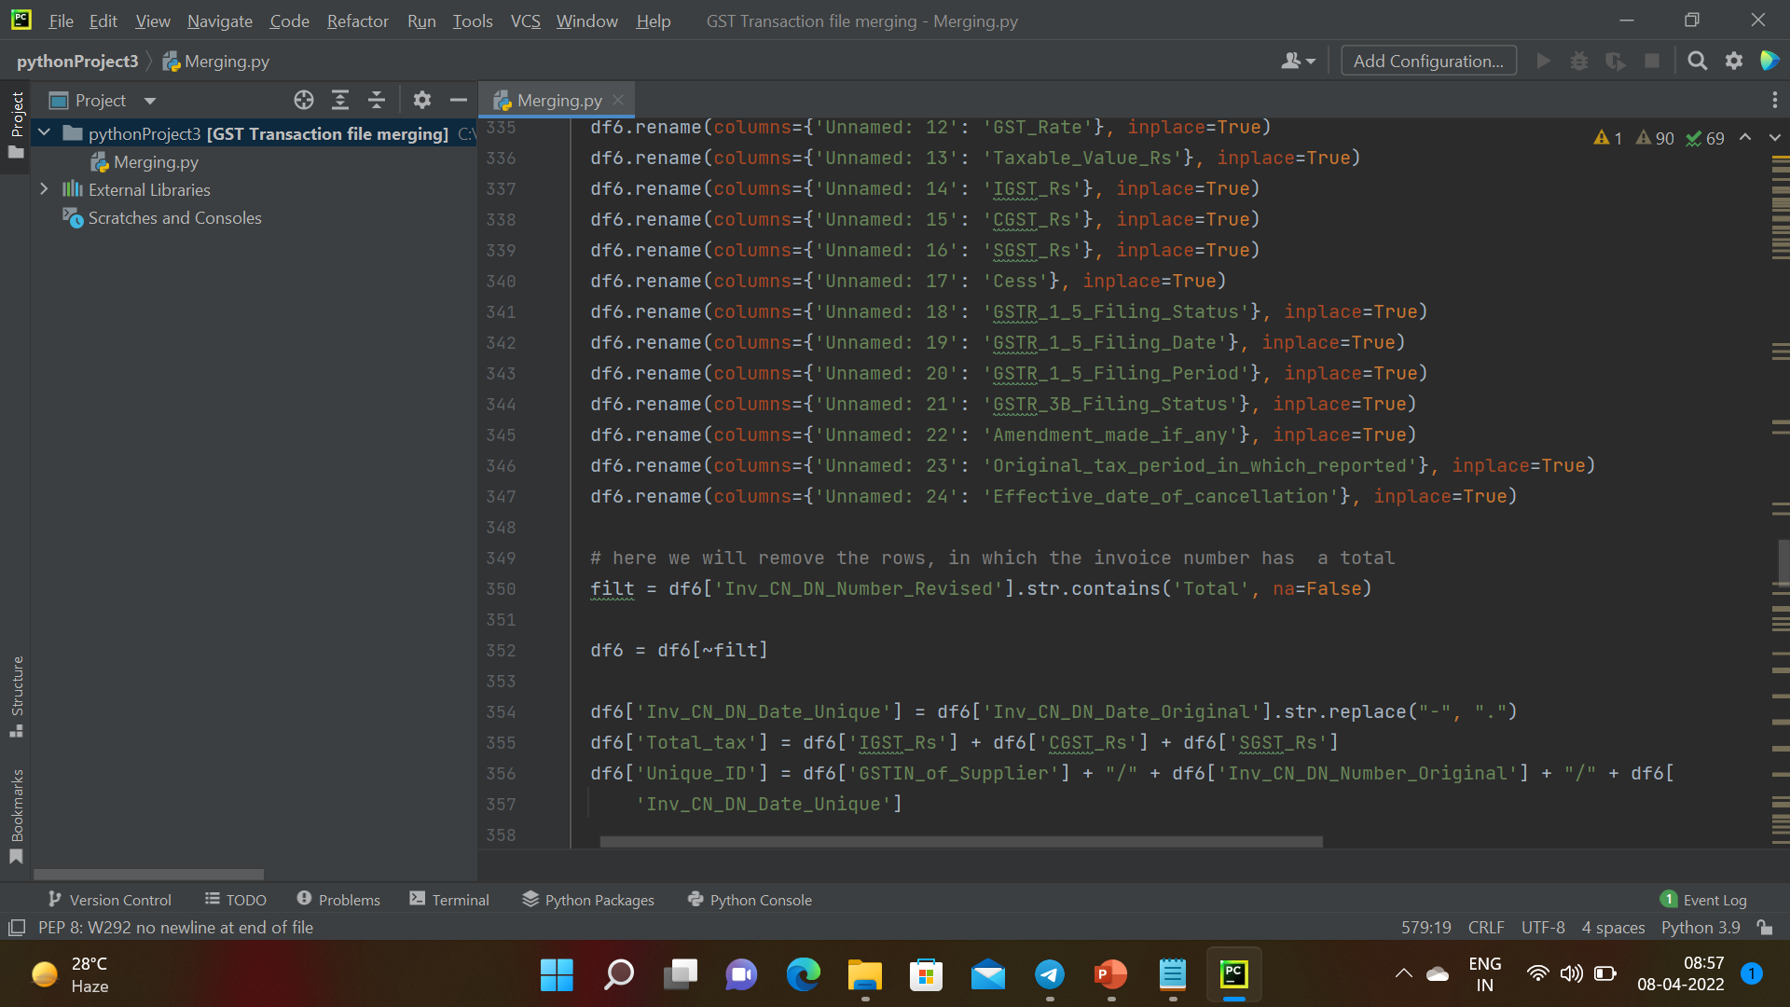

Slide 11
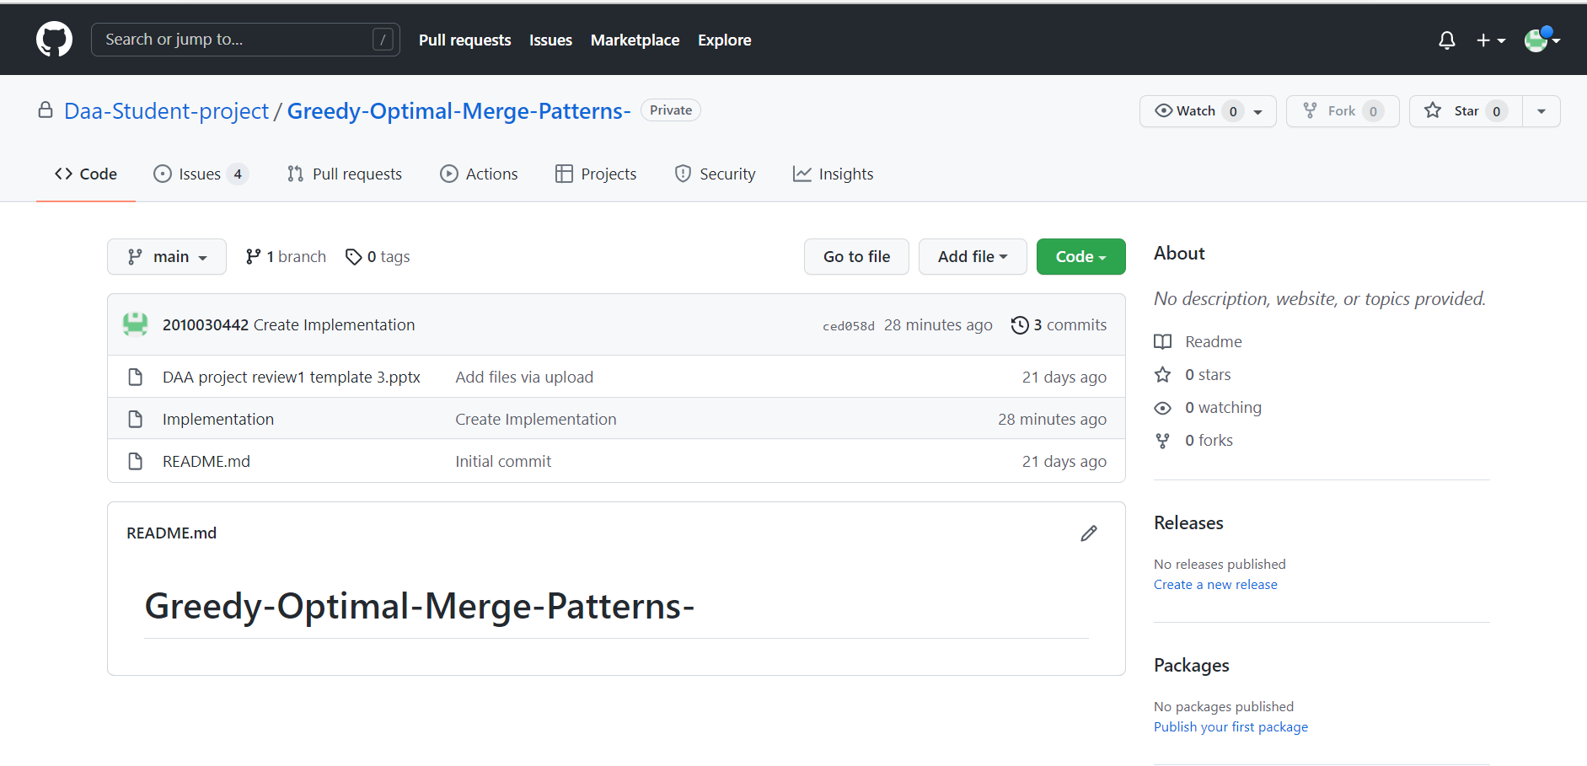
Github commits

Slide 12
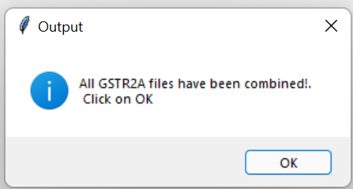
Results

Slide 13
Future scope
Proposing a new method to merge the files in a different way so that we can files number of files merged in the minimum amount of time.
Creating and developing the model of the project
Developing the code with high accuracy rate of file merging

Slide 14
THANK YOU

